Slide 1
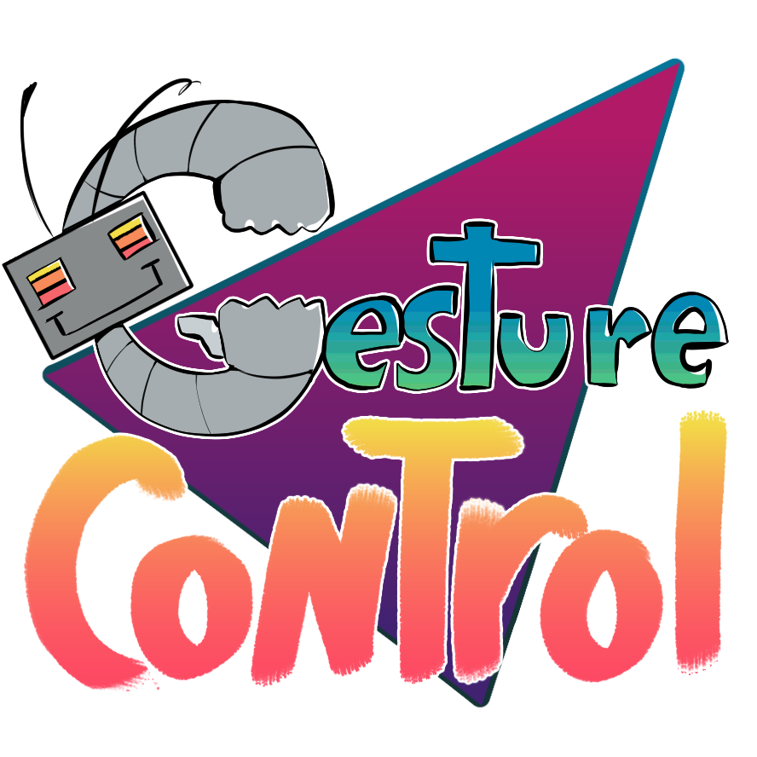
Ivana Hernandez, Keren Zhang, Joey Chen
Notes:
Hello and welcome to gesture control! A website that use ai hand tracking technology to help you with the ASL alphabet

Slide 2

Meet Us
Emu Unicorn Sauce (EUS)
Joey - Software Dev major
Worked on obtaining the required code for the project.
Ivana - Software Dev major
Worked on/trained the AI and the grading system.
Drew the logo for Gesture Control and the EUS mascot
Keren - Data Science major
Worked on integrating the code into a website with both front-end and back-end.
Emu Unicorn Sauce mascot, animated by Ivana

Slide 3
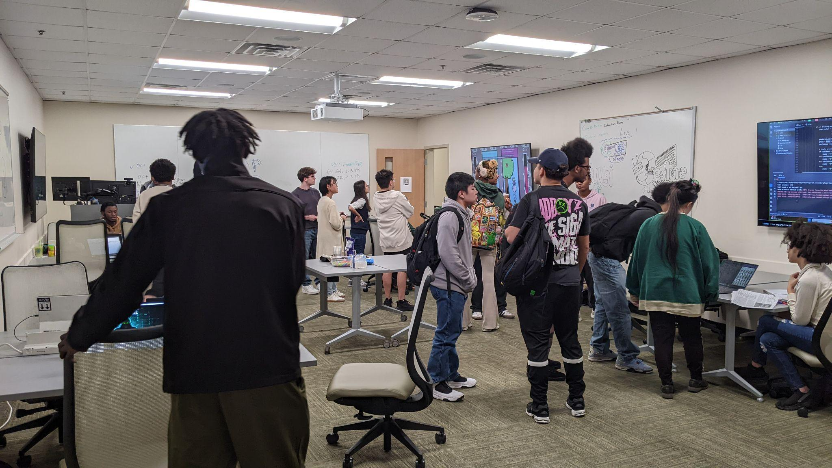
About TAP
The Technology Ambassador Program (TAP) prioritizes simplifying technology in the view of the common eye, which is why anybody can enroll: from experienced programmers to the technologically illiterate.
Students will choose a project to work on during the semester and maintain motivation consistently to progress through all checkpoints.
Outside the learning of technical skills needed to work on your project, TAP also leads to developing self-discipline and soft skills, which are arguably just as important!
Image from 10/10/25 TAP EXPO
Notes:
Anyone can join TAP whether you’re an experienced programmer or technologically illiterate anyone can join.
During their semester students will be in groups and turn one of their ideas into a project
You will also be developing your soft skills because they’re just as important as your technical skills

Slide 4
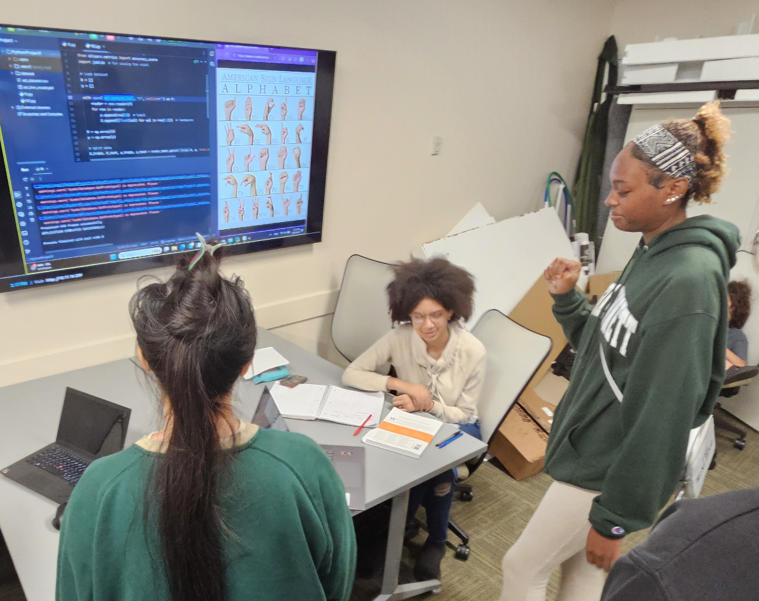
Our Goals
Through Gesture Control, we can showcase a real-world use of AI through the idea of teaching sign language to the user.
Users will learn how to sign a given word by the individual letters in the American Sign Language (ASL); the program grades you on your accuracy.
AI, especially outside of LLMs, may seem a little alien when compared to other forms of technology. Hopefully we can demystify AI, as this involves basic machine learning that anybody can learn.
Image from 10/10/25 TAP EXPO

Slide 5
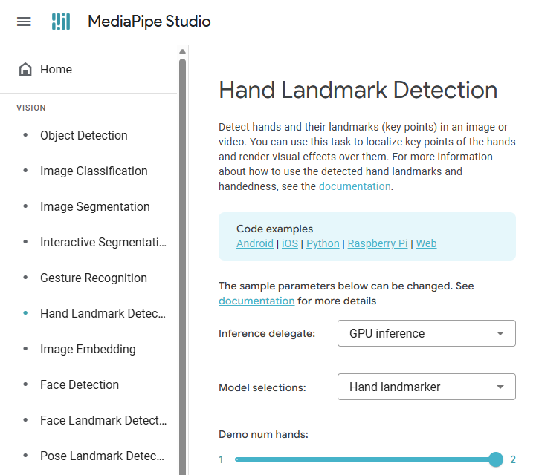
Hand Recognition
‘Hand Landmark’ code is from MediaPipe, trained off thousands of hands https://mediapipe-studio.webapps.google.com/studio/demo/hand_landmarker
It divides the hand into 21 points, with each point having its own coordinates
Notes:
‘Supervised’ meaning the algorithm learns from a dataset with each data point being labeled.
K=3, so the nearest 3 data points (‘neighbors’) are used for grading.
Explain ‘neighbors’
We only have around 20 samples per letter, so the model is not very accurate, and you can’t get a high grade.

Slide 6
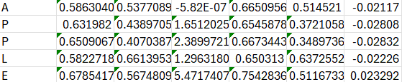
The AI
Using the MediaPipe code, we had each hand as a set of coordinates to a corresponding letter into a CSV file.
15 samples for each letter was collected (though ideally, you would need hundreds for accuracy)
The CSV file was used to train the AI for ‘letter recognition’
Notes:
You’d type in a word, in this case ‘APPLE’ and it will open up the webcam. The user’s hand would come into frame, and they would have to sign each letter one by one (with spacebar making the program move to the next letter).

Slide 7
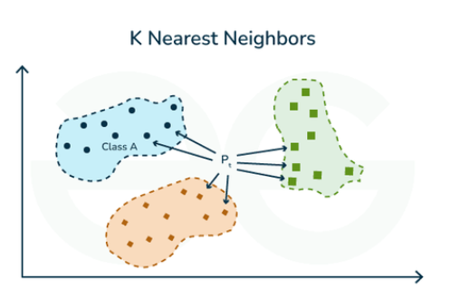
KNN (K-Nearest Neighbors)
K-Nearest Neighbors (KNN) is a simple supervised algorithm. In this case, ideal for classification.
As the user’s hands come into frame, the live coordinates for a given letter are tested against the coordinates in the dataset.
Finally, a basic ‘if-then’ A-D grading system based off how close you were to the predicted letter.
Notes:
‘Supervised’ meaning the algorithm learns from a dataset with each data point being labeled.
It takes a new data point (say in this case, your hand as it comes into frame) and compares it to the data stored in the database.
It will classify the new data point when compared to the closest values in the dataset, in this case, predict what letter you are trying to sign.

Slide 8
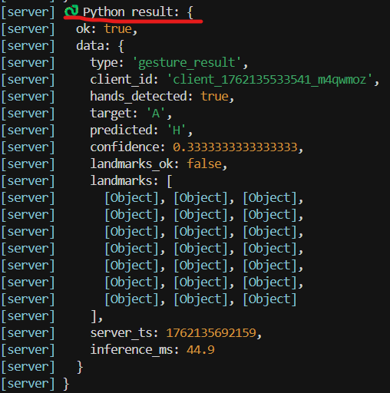
Setting the AI model to run as our backend
AI doesn’t “see” a picture like humans. It tracks 21 hand joint points → analyzes geometry → makes a guess.
Low confidence or bad points = we ignore that frame
AI is smart, but it also doubts itself. We need to check confidence before trusting its answer.
Notes:
Our AI doesn’t actually see a picture like humans. It only tracks 21 hand keypoints.
It analyzes the geometry of these points and makes its best guess for the gesture.
If the points are unclear or the confidence is low, we simply ignore that frame.
So AI is smart, but it also doubts itself — and we only trust it when it’s confident.

Slide 9
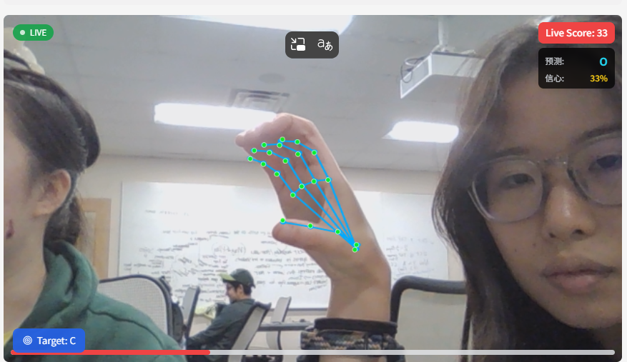
Notes:
Here you can see our real-time hand tracking, where the model detects 21 keypoints.
These small green dots are the only information the AI uses to understand gestures.
In the top-right, the confidence is only 33%, meaning the AI is unsure.
Whenever the points are unstable or unclear, the system filters that frame out.

Slide 10
Data stored in JSON format = like a excel sheet in coding language
Field | Meaning
predicted: "H" | AI’s guess for the gesture
target: "A" | The gesture we wanted it to detect
confidence: 0.33 | AI’s confidence level (0–1). 0.33 = “I’m not sure…”
landmarks_ok: false | Hand points were not clear → don't trust this frame
inference_ms: 44.9 | Time AI needed to think (speed / performance)
landmarks: [...] | 21 hand key points (AI sees bones, not skin)
Notes:
The AI returns its results in JSON format — basically a coding version of an Excel sheet.
It includes what the AI predicted, what we expected, the confidence level, and all 21 keypoints.
A confidence of 0.33 means the AI is saying, ‘I’m not sure.’
If landmarks_ok is false, the hand points weren’t clear, so we don’t trust that frame.

Slide 11
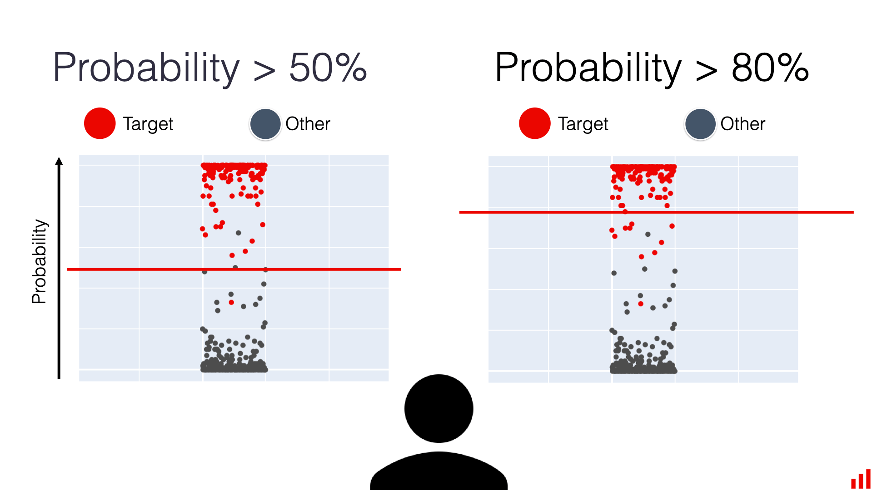
How We Use the AI Output (Decision Logic)
To make the system stable and fair, we don’t trust every frame.
We check three things before showing a result:
1) Quality first (Visibility ≥ 0.4: Camera sees the hand clearly) If the hand keypoints are unclear → ignore this frame.
No clean signal = no decision.
2) Confidence threshold If the confidence < 0.6, we don’t show it.
Low confidence = “AI isn’t sure yet.”
3) Time stability (5-frame vote: Avoid random guesses) The same gesture must appear across multiple frames (ex: 5 frames)
One lucky guess ≠ real answer.
Notes:
We don’t trust every frame — the system checks three things before showing a result. First is quality: if visibility is below 0.4, we ignore that frame.
Second is confidence: if it’s under 0.6, we hide the prediction.
Third is time stability: the same gesture must appear across multiple frames.
One lucky guess doesn’t count as a real answer.

Slide 12
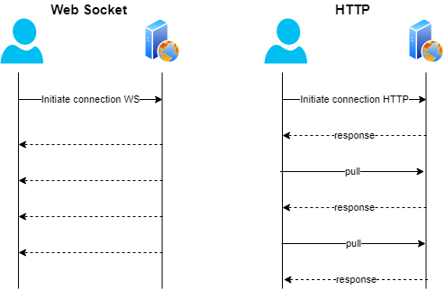
Human + AI communications: WebSocket or HTTP
HTTP (OLD telephone)
One-time request → one-time response
Connection closes after each message
Good for: forms, loading pages, downloading files
Notes:
There are two common ways for humans and AI to communicate: HTTP or WebSocket.
HTTP is like an old phone call — one request, one response, then the connection closes.
It works well for simple tasks like forms or loading pages.
But for real-time gesture tracking, HTTP is too slow and too disconnected.

Slide 13
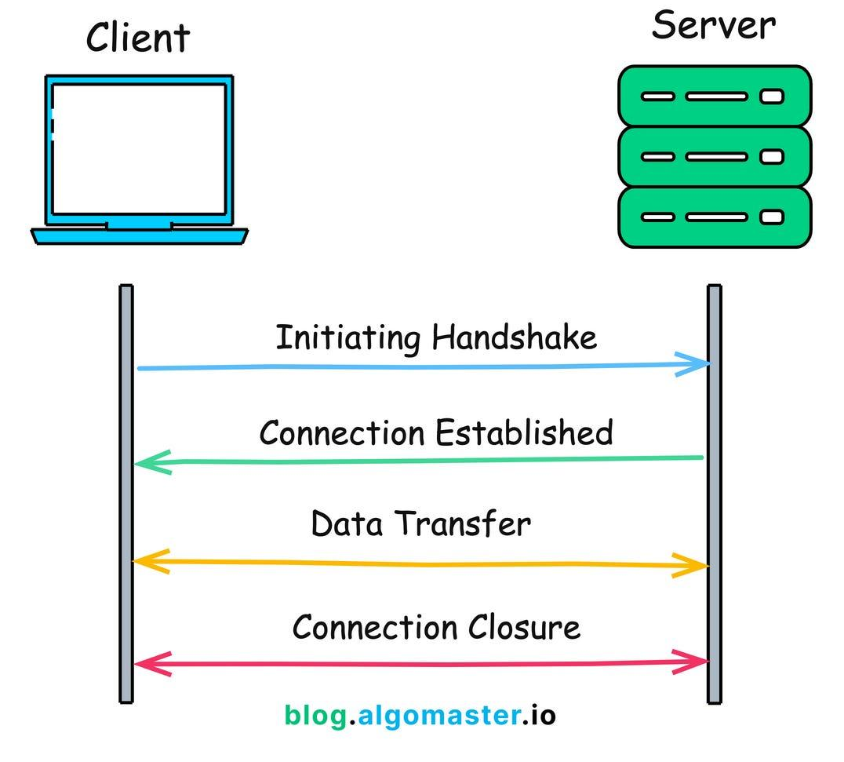
WebSockets
WebSocket(iPhone)
Client & server connect once → stay connected
Can send messages both directions anytime
Good for: real-time apps (games, video chat, gesture tracking, collaboration)
Our project:
Camera sends many hand-tracking frames per second → We need continuous, fast communication → WebSocket is the better choice
Notes:
WebSocket works more like a continuous call — connect once, and stay connected. Client and server can send messages anytime, in both directions.
This makes it perfect for real-time apps like games, video chat, and gesture tracking.
Since our camera sends many frames per second, WebSocket gives us the speed we need.

Slide 14
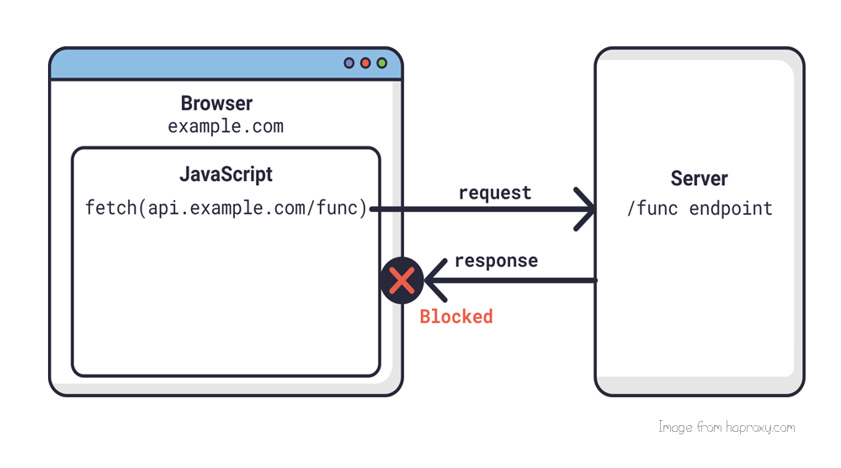
CORS Explained for Beginners
Cross-Origin (CORS) - Why WebSocket Sometimes Gets Blocked
Even if your front-end and back-end are both on Render, they have different URLs, so they count as being from “different places.” The browser says:
“Are you sure you’re allowed to connect?”
To fix this, your server must say: “Yes, I allow connections from this front-end!”
This is called CORS — a browser safety rule.

Slide 15
Try Out Our Project!

Slide 16
Head to the Website
https://gesture-control-xli6.onrender.com
At the drop-down, select ‘Webcam’
Click ‘Start Camera’
Use the ASL alphabet picture while playing with the camera.
Have Fun! Try A to E. 😊
Notes:
预测=Predict：what I am trying to sign; 信心=Confidence: how similar that is to the standard sign

Slide 17
Thanks for coming!
Any questions?

